Slide 1
Wood County Community Health Improvement Planning
Meeting #3
Gabrielle (Gabbey) MacKinnon, MPH | May 13th, 2022

Slide 2
Zoom Housekeeping Rules
Please mute yourself so everyone can hear without background noise interruptions.
If you have a comment, please wait until I am done going over the slide then please feel free to unmute yourself and provide feedback. You can also type your comment in the chat box.
We will be recording this meeting for our internal use. The recording will not be shared or sent out to anyone. This allows us to go back and listen to make sure that we are taking down everyone's feedback.

Slide 3
CHIP Planning Timeline
In the next 4 meetings, we will complete the following planning steps:
Meeting 1: (Tuesday 4/8)
Choose Priorities
Rank Priorities
Quality of Life Survey
Meeting 2: (Tuesday 4/22)
LPHSA
Forces of Change
Community Themes & Strengths
Meeting 3: (Tuesday 5/13)
Quality of Life Results
Gap Analysis and Potential Strategies Results
Meeting 4: (Tuesday 6/10)
Review of Action Steps
Review of Draft Plan
Resources

Slide 4
CHIP Priorities
Priority Factors
Community Conditions
Health Behaviors
Access to Care
Priority Health Outcomes
Mental Health & Addiction
Chronic Disease
Social Wellness

Slide 5
Quality of Life Results
PDF Attachment

Slide 6
Gap Analysis and Potential Strategies Results

Slide 7
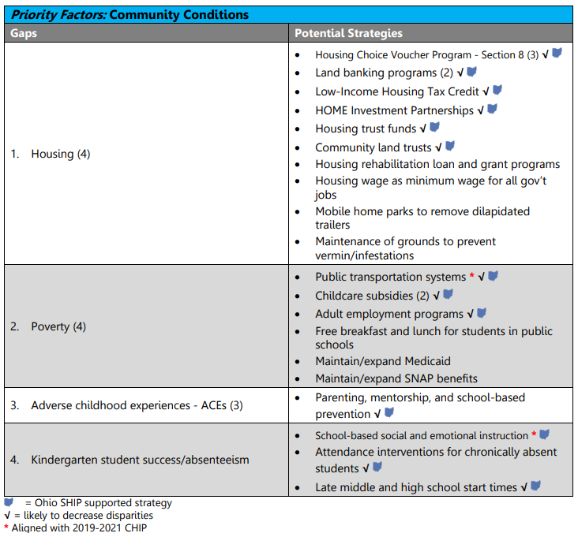
Gap Analysis and Strategies Results – Community Conditions

Slide 8
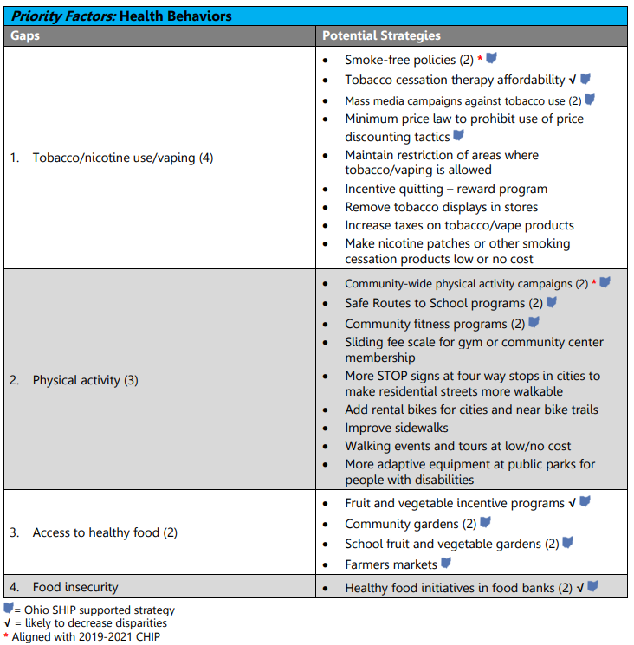
Gap Analysis and Strategies Results – Health Behaviors

Slide 9
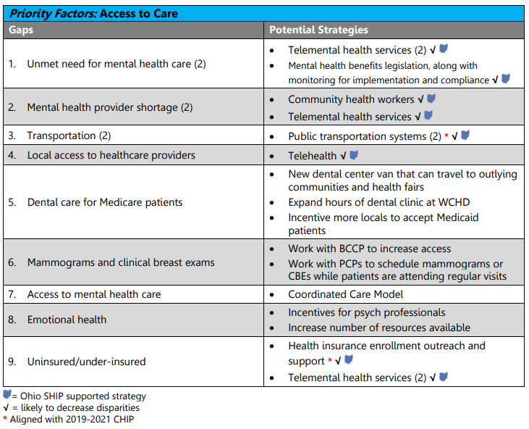
Gap Analysis and Strategies Results – Access to Care

Slide 10
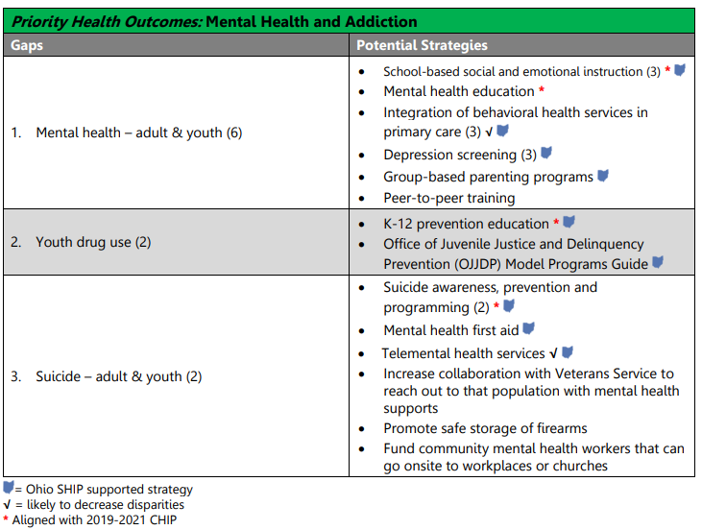
Gap Analysis and Strategies Results – Mental Health & Addiction

Slide 11
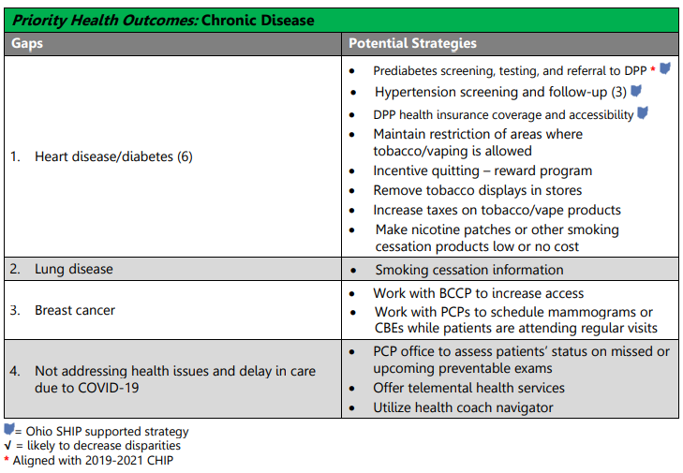
Gap Analysis and Strategies Results – Chronic Disease

Slide 12
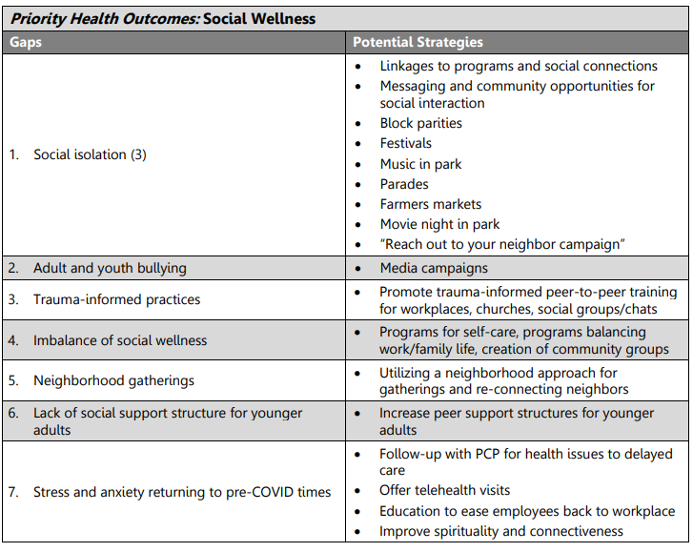
Gap Analysis and Strategies Results – Social Wellness

Slide 13
Next Steps

Slide 14
Next Meeting Agenda
Date:
Friday, June 10th @9a-12p
Tasks:
Review of draft report
Organizations/agencies sign up as lead for strategies
Resources

Slide 15
Questions or Comments?

Slide 16
Thank you!

